Slide 1

CUSTOMER PERSONALITY ANALYSIS
PROJECT BY:
Dhanashri Kanukale
Lionel Mendonsa
Vijay Kamble
Mahesh Pal
Sai Srinivas
Munesh Shaganti
A Machine learning based customer
segmentation project.

Slide 2
ABOUT PROJECT

Slide 3
WHAT IS CUSTOMER PERSONALITY ANALYSIS?
A B OUT PROJ EC T
Customer Personality Analysis using Segmentation and Exploratory Data Analysis is a comprehensive study that leverages data-driven techniques to gain insights into consumer behavior and preferences.

Slide 4
OBJECTIVE
A B OUT PROJ EC T
A case requires to develop a customer segmentation to give recommendations like type of products with respect to target customers groups.

Slide 5
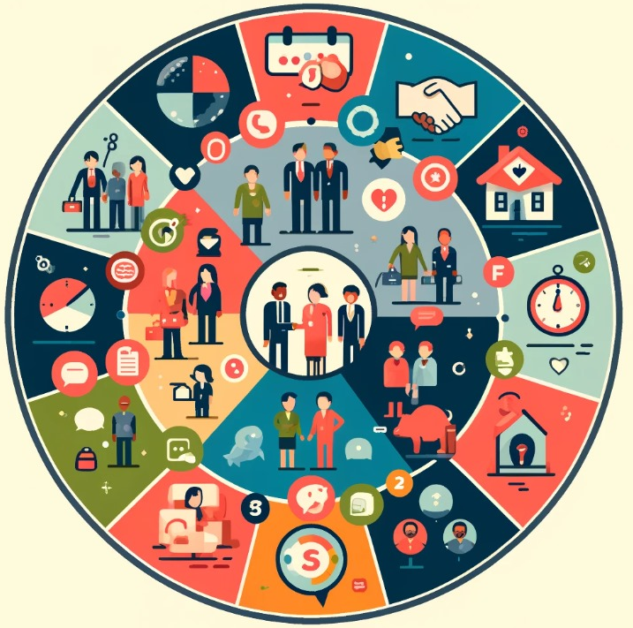
OBJECTIVE
A B OUT PROJ EC T
WHATS THEIR INCOME LEVEL?
WHATS THEIR AGE?
WHATS THEIR EDUCATION LEVEL?
ARE THEY MARRIED?
HOW MANY KIDS DO THEY HAVE?
FROM WHERE DO THEY BUY THE PRODUCTS?
HOW MUCH DO THEY SPEND ON DIFFERENT PRODUCTS?
DID THEY ACCEPT ANY OF OUR CAMPAIGNS?
FOR HOW LONG ARE THEY OUR CUSTOMERS?

Slide 6
ABOUT DATASET

Slide 7
Dataset
The sample Dataset summarizes the purchase behavior of about 2240 active customers. The file is at a customer level with 9 behavioral variables.
Variables of Dataset
Education
Marital Status
Income
Kids
Expense
Total accepted campaign
Total purchases
Age
Customer for
ABOUT DATASET

Slide 8
TOOLKIT AND ALGORITHMS

Slide 9



TECH TOOLKITS USED
CUSTOMER PERSONALITY ANALYSIS
Python
Python is the programming language which is used to code the project. Various algorithms used are coded in Python
Streamlit
Streamlit is an open source framework for Machine learning and Data Science. It is used for prototype and deployment purpose of the models.
Jupyter Notebook
Jupyter notebook is the effective IDE used for coding in Python. It is very easy to use and widely used over the industry.

Slide 10
STEPS AND PROCESS

Slide 11
Research and business understanding
The first thing you have to do before you solve a problem is to define exactly what it is. You need to be able to translate data questions into something actionable.
1
Data pre-processing
Data preprocessing can refer to manipulation or dropping of data before it is used in order to ensure or enhance performance, and is an important step in the data mining process.
2
PROJECT PROCESS
Exploratory Data analysis
Exploratory data analysis is an approach of analyzing data sets to summarize their main characteristics, often using statistical graphics and other data visualization methods.
3
Model Building
Model building process where different machine learning algorithms are used to make different machine learning models for various applications.
4
Model Deployment
Model Deployment is the process where various ML algorithms are deployed on various platforms like flask, Streamlit, various open source platforms, etc. Here we have used Streamlit to deploy our ML project.
5

Slide 12
Algorithms used in the project
CUSTOMER PERSONALITY ANALYSIS
K-means clustering
K Nearest Neighbor
Support Vector Classifier
Principle Component Analysis
Random Forest

Slide 13
INSIGHTS GENERATED

Slide 14
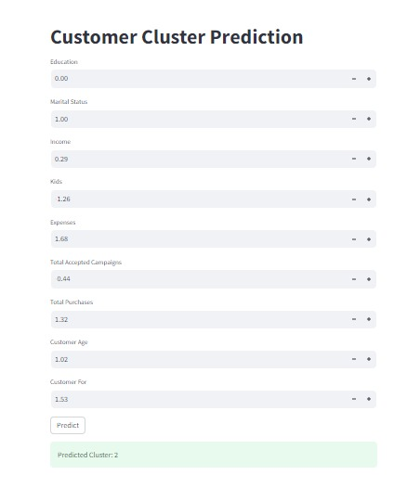
OUTPUT SCREEN
INS IGH TS

Slide 15
INPUTS
CUSTOMER PERSONALITY ANALYSIS INS IGH TS
Education – 0
Marital Status - 1
Income – 0.28
Kids - -1.26
Expense - 1.68
Total accepted campaign - -0.43
Total purchases - 1.31
Age - 1.01
Customer for - 1.52

Slide 16
OUTPUTS
CUSTOMER PERSONALITY ANALYSIS INS IGH TS
Cluster 1:
People with less expenses
People who are married
Parents of more than 3 kids
People who have low income
Cluster 2:
people with more expenses
People who are single
Parents who have less than 3 kids
People with high income.
Age is not the criteria but it is observed to some extent that people who are older fall in cluster 2

Slide 17
DEPLOYMENT
CUSTOMER PERSONALITY ANALYSIS
We have created a Streamlit Application based on this clustering technique, where we are taking the customer details & identifying which cluster the customer belongs to.

Slide 18

CUSTOMER PERSONALITY ANALYSIS
PROJECT BY:
Dhanashri Kanukale
Lionel Mendonsa
Vijay Kamble
Mahesh Pal
Sai Srinivas
Munesh Shaganti
A Machine learning based project

